Slide 1



Seminar on Data Science & Business Analytics
Submitted to Submitted by
Mr. Vijay Bijlwan Kartikeya
18134503008
Department of Computer Science & Engineering
School of Engineering & Technology

Slide 2


Contents
Company Profile
Technology Stack
Supervised Learning
Project
Benefits
Experience

Slide 3

Company Profile
To inspire students, help them innovate and let them integrate to build the next generation humankind.
Inspire
To inspire, motivate and encourage students to learn, create and help build a better society.
Innovate
To teach new ways of thinking, to innovate and solve the problems on their own.
Integrate
To let the students integrate, and help each other, learn from each other and do well together.

Slide 4
Technology Stack
Language-
Python
Compiler-
1.Jupyter Notebook
2.Anaconda

Slide 5
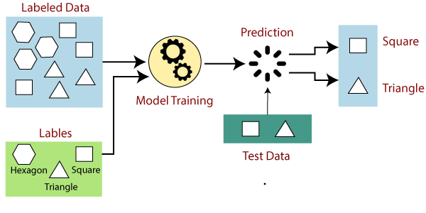
Supervised Learning
Supervised learning is an approach to creating artificial intelligence (AI), where a computer algorithm is trained on input data that has been labeled for a particular output. The model is trained until it can detect the underlying patterns and relationships between the input data and the output labels, enabling it to yield accurate labeling results when presented with never-before-seen data

Slide 6
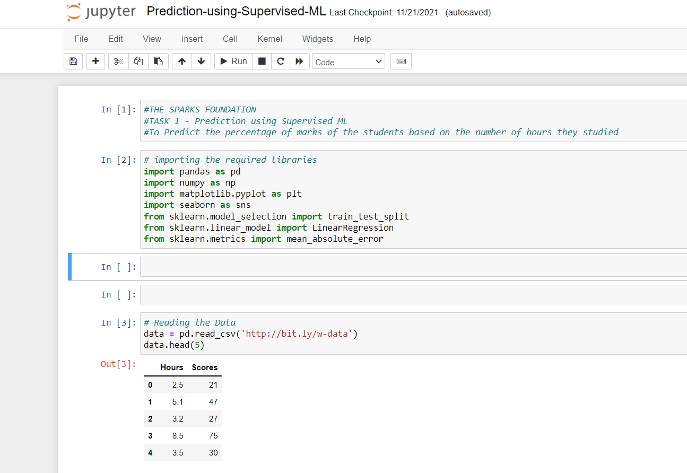
Project

Slide 7
Benefits
Supervised learning in Machine Learning allows you to collect data or produce a data output from the previous experience.
Helps you to optimize performance criteria using experience.
Supervised machine learning helps you to solve various types of real-world computation problems.

Slide 8
Experience
We are a group of passionate data science professionals, who decided to dedicate their careers in building Analytics and Data Science community. We feel passionately about creating next generation data science community and ecosystem and will leave no stone unturned to do the same. (www.thesparksfoundationsingapore.org/)

Slide 9
References
https://www.guru99.com/supervised-machine-learning.html
https://www.thesparksfoundationsingapore.org/

Slide 10
Thank You

